Slide 1
Introducing spark.ml
Movie recommendations using Spark’s machine learning library

Slide 2
ML capabilities
Feature extraction
Term Frequency / Inverse Document Frequency useful for search
Basic statistics
Chi-squared test, Pearson or Spearman correlation, min, max, mean, variance
Linear regression, logistic regression
Support Vector Machines
Naïve Bayes classifier
Decision trees
K-Means clustering
Principal component analysis, singular value decomposition
Recommendations using Alternating Least Squares

Slide 3
ML uses dataframes
The previous API was called “MLLib” and used RDD’s and some specialized data structures
MLLib is deprecated in Spark 3.
The newer “ML” library just uses dataframes for everything.

Slide 4
For more depth
I really like “Advanced Analytics with Spark” from O’Reilly
Examples in Spark SDK
General ML courses

Slide 5
Let’s make some movie recommendations
val data = spark.read.textFile("../ml-100k/u.data")
val ratings = data.map( x => x.split('\t') ).map( x => Rating(x(0).toInt, x(1).toInt, x(2).toDouble) ).toDF()
val als = new ALS()
.setMaxIter(5)
.setRegParam(0.01)
.setUserCol("userId")
.setItemCol("movieId")
.setRatingCol("rating")
val model = als.fit(ratings)
IT’S JUST THAT EASY… Let’s run it.

Slide 6
But the results aren’t really that great.
Very sensitive to the parameters chosen. Takes more work to find optimal parameters for a data set than to run the recommendations.
Can use “train/test” to evaluate various permutations of parameters
But what is a “good recommendation” anyway?
I’m not convinced it’s even working properly internally.
Putting your faith in a black box is dodgy.
We’d get better results using our movie similarity results instead, to find similar movies to movies each user liked.
Complicated isn’t always better.
Never blindly trust results when analyzing big data
Small problems in algorithms become big ones
Very often, quality of your input data is the real issue

Slide 7
MLLib is still really useful, though.

Slide 8
Linear Regression with spark.ml

Slide 9
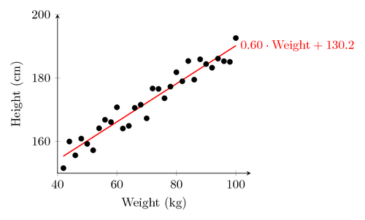
What is Linear Regression?
Fit a line to a data set of observations
Use this line to predict unobserved values
I don’t know why they call it “regression.” It’s really misleading. You can use it to predict points in the future, the past, whatever. In fact time usually has nothing to do with it.

Slide 10
How does Linear Regression Work?
Usually using “least squares”
Minimizes the squared-error between each point and the line
Remember the slope-intercept equation of a line? y=mx+b
The slope is the correlation between the two variables times the standard deviation in Y, all divided by the standard deviation in X.
Neat how standard deviation how some real mathematical meaning, eh?
The intercept is the mean of Y minus the slope times the mean of X

Slide 11
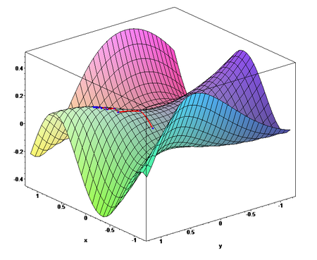
There’s More than One Way to Do it.
Spark Streaming uses a more complex technique called Stochastic Gradient Descent (SGD)
Friendlier to multi-dimensional data as it looks for contours in higher dimensions

Slide 12
Linear Regression with spark.ML
Set up your model like this: val lir = new LinearRegression()
.setRegParam(0.3) // regularization
.setElasticNetParam(0.8) // elastic net mixing
.setMaxIter(100) // max iterations
.setTol(1E-6) // convergence tolerance
You train the model and make predictions using tuples that consist of a label, and a vector of features. In this case the “label” is the value you’re trying to predict – usually your Y axis – and the “feature” is your X axis or other axes.
So you train it with a bunch of known x,y points
And predict new Y values for given X’s using the line the model created.
Can work with more than 2 dimensions (multiple features)

Slide 13
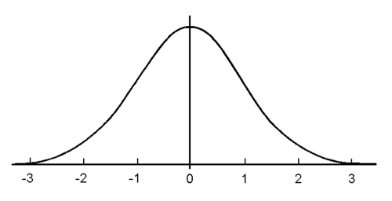
Gotchas With SGD Linear Regression
SGD doesn’t handle “feature scaling” well. It assumes your data is similar to a normal distribution:
So, you need to scale your data down and back up again when you’re done.
It also assumes your y-intercept is 0, unless you call fitIntercept(true)

Slide 14
Let’s Try It Out
We’ll fabricate some data for average page speed and revenue generated from session data on an online store
Can we predict revenue based on page speed using a linear model?

Slide 15

Exercise
Predicting real estate values with decision trees and Spark

Slide 16
Real-world data
data/realestate.csv (credit: Yeh, I. C., & Hsu, T. K. (2018). Building real estate valuation models with comparative approach through case-based reasoning. Applied Soft Computing, 65, 260-271.)
Source: https://archive.ics.uci.edu/ml/datasets/Real+estate+valuation+data+set#

Slide 17
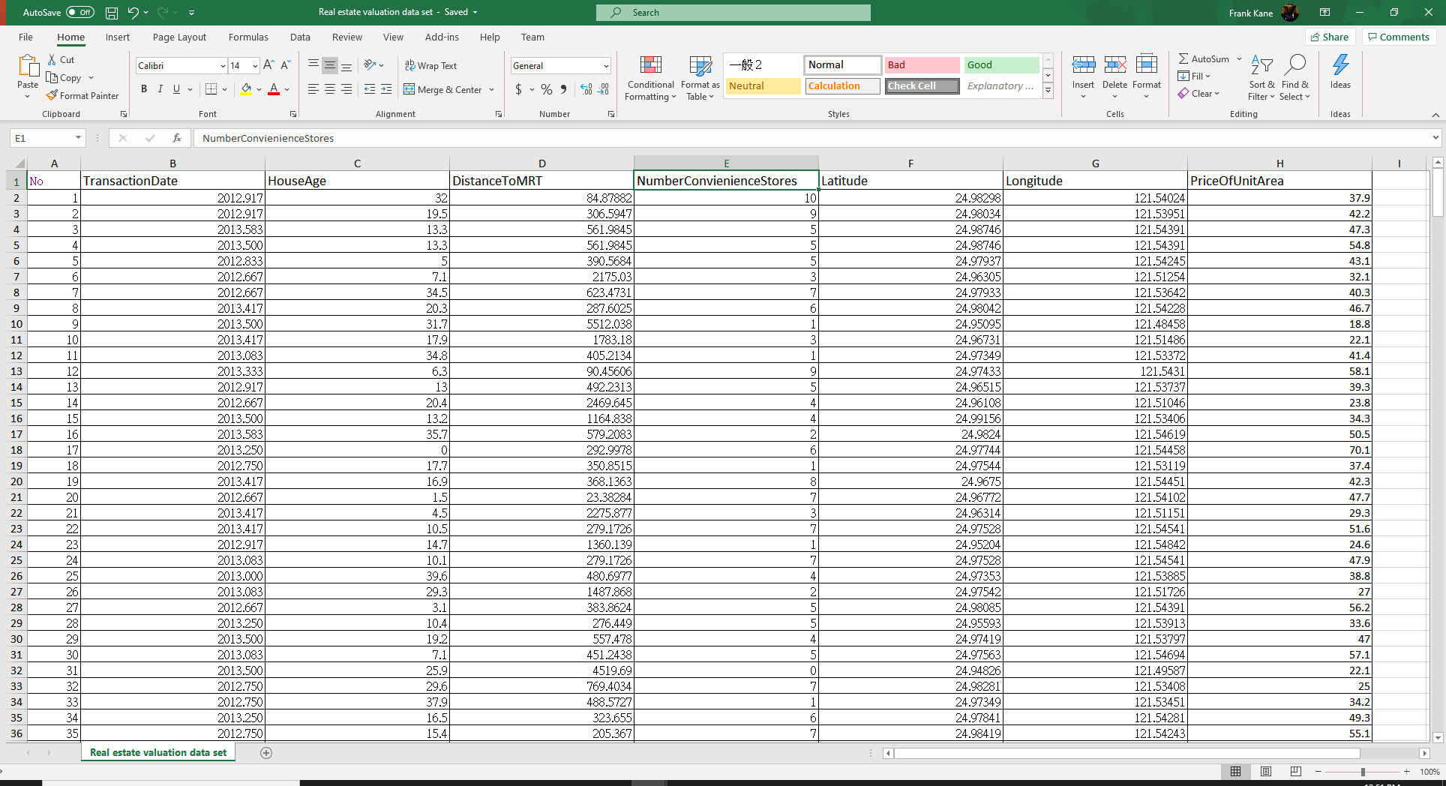
Exploring the data

Slide 18

Your task
Predict the price per unit area based on house age, distance to MRT (public transportation), and number of nearby convenience stores

Slide 19
strategy
Use a DecisionTreeRegressor instead of LinearRegression
Decision trees can handle data in different scales better
Start with a copy of LinearRegressionDataFrameDataset.scala
Note that we have a header row – no need to hard-code a schema for reading the data file

Slide 20
Useful snippets
You can have multiple input columns in a VectorAssembler
setInputCols(Array(“col1”, “col2”, …))
.option(“header”, “true”).option(“inferSchema”, “true”)
Remember to match case class field names to the header names
DecisionTreeRegressor
Can do without hyperparameters
.setLabelCol() specifies a label column (what you’re predicting) if its name is not “label”

Slide 21

Good luck

